Slide 1
Cyclistic Bike-Share Case Study
Analyzing member vs. casual rider behavior Author: Sumaiya Mohammed Hanif Date: 15-07-2025

Slide 2
Business Task
Goal: Understand how annual members and casual riders use Cyclistic bikes differently. Provide actionable insights to convert casual riders into annual members and increase revenue.

Slide 3
Data Sources
Divvy 2019 Q1 dataset
Divvy 2020 Q1 dataset
Publicly available, anonymized data
Includes ride IDs, timestamps, stations, and user type

Slide 4
Data Cleaning & Preparation
Renamed columns for consistency
Added missing columns to 2019 data
Parsed date-time fields
Combined both datasets
Calculated ride length (minutes)
Filtered unrealistic rides (<1 min or >24 hrs)
Created day_of_week column

Slide 5
Analysis Summary
Key Findings:
Casual riders have longer average ride durations
Casual ridership peaks on weekends (recreational use)
Annual members ride more on weekdays (commuting patterns)

Slide 6
Summary Statistics Table
member_casual | mean_ride_length | median_ride_length | max_ride_length | min_ride_length
Casual | 40.14820 | 23.13333 | 1435.917 | 1.016667
Member | 11.61133 | 8.65000 | 1432.133 | 1.000000

Slide 7
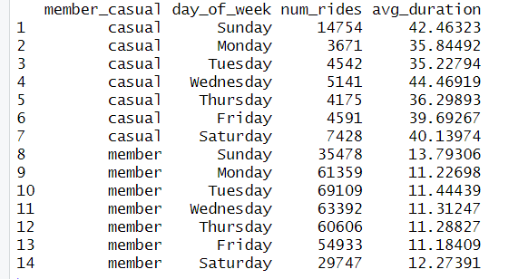
Rides by Day of Week Table

Slide 8
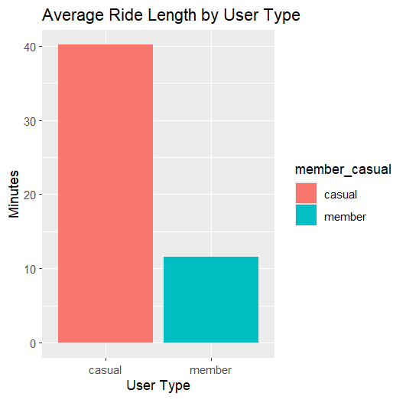
Average Ride Length by User Type Chart

Slide 9
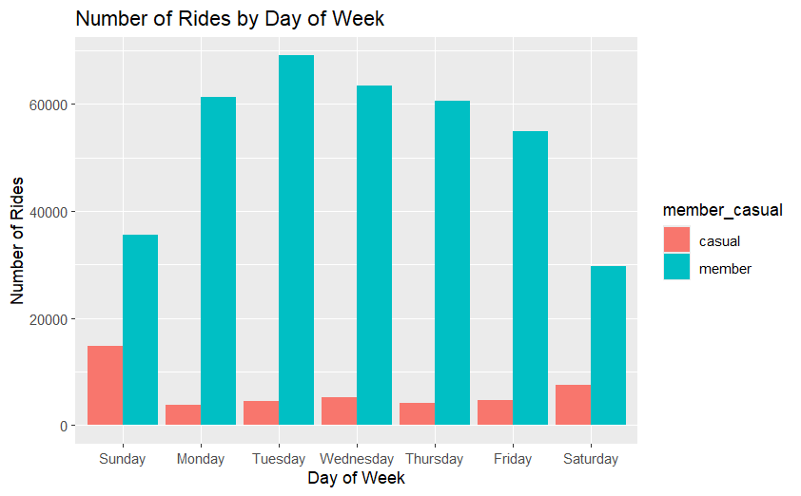
Number of Rides by Day of Week (Members vs. Casual) Chart

Slide 10
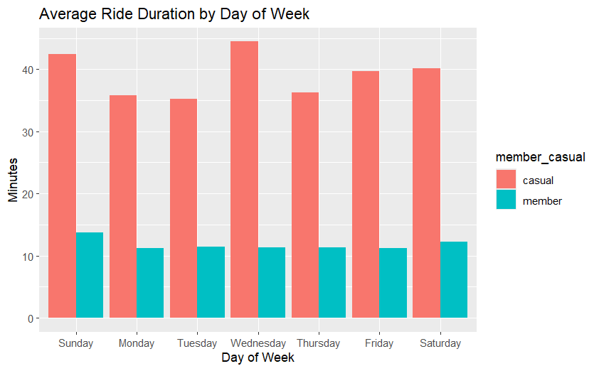
Average Duration by Day of Week Chart

Slide 11
Recommendations
Based on the analysis:
Weekend membership promotions for casual riders.
Commuter-focused advertising highlighting weekday convenience.
Personalized membership offers for frequent casual riders.

Slide 12
Thank You! Questions?

